Slide 1
Design Methodologies
6 Approaches to Design
Notes:
http://userpages.umbc.edu/~khoo/survey2.html

Slide 2
Top-Down Design
Top-down decomposition requires identifying the major higher-level system requirements and functions, and then breaking them down in successive steps.
“Start with a vision, figure out the details.”
Notes:
Here is what we need to do. How do we do it?

Slide 3
Bottom-Up Design
A bottom-up system of design is one that responds to actual user needs rather than following a centralized vision.
“Start with the details, form the vision.”
Notes:
Here is what we need to happen. How do we do it?

Slide 4
Object Oriented Design
OOD creates a model of the real world and maps it to the software structure.
“What are the major actors?”
Notes:
Here is what it might look like in real life, let's make objects out of everything.

Slide 5
MVC
The Model-View-Controller relationship helps us identify three areas common to most software applications.
Model – The data we are concerned with
View – The way that data is shown to the user
Controller – How the user or OS interacts with the model or view (aka. the driver app)

Slide 6
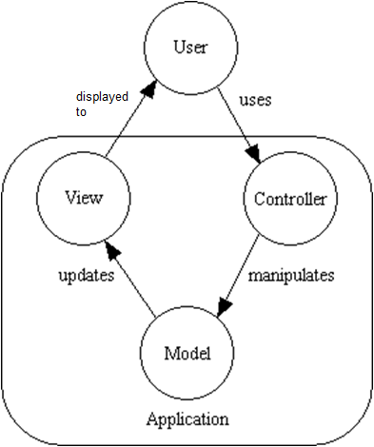
MVC
User input, interpreted by the controller, may change the model data.
If the model changes, the view is updated to reflect those changes.
Notes:
http://www.tonymarston.net/php-mysql/model-view-controller.html
http://en.wikipedia.org/wiki/Model-view-controller

Slide 7
Structured Design
SD views systems from two perspectives : as the flow of data and the transformations that data flow undergoes through a system.
“How does the data flow?”
Notes:
Here is the data; we need it to look like this.
Structured design is also known as data-oriented design
http://gamesfromwithin.com/data-oriented-design

Slide 8
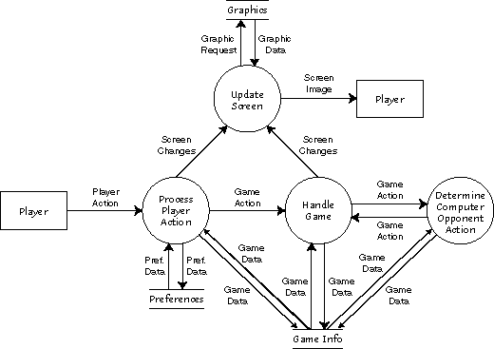
Structured Design – module hierarchies
Cohesion
Coupling
Notes:
These two concepts help to measure the connectedness of the logical dependencies within and between modules.
Cohesion is about how well a group of things work together.
Coupling is about how interconnected and interdependent two modules of code are.
http://en.wikipedia.org/wiki/Structured_analysis#Structured_Design
https://thebojan.ninja/2015/04/08/high-cohesion-loose-coupling

Slide 9
Cohesion - Encapsulation
Beyond hiding data, encapsulation also involves the cohesiveness of a module.
When it does only a single, precise task, it will be simpler to reuse and to extend.
Notes:
It should do one thing and ONLY one thing.
It should do that task with minimal dependency.
Modifications to the module should not break other modules.

Slide 10
Coupling - Modularity
Coupling is a measure of logical dependency.
When a system is tightly coupled to another, it becomes nearly impossible to re-use one piece independently from the other.

Slide 11
Classic Waterfall Lifecycle
Requirements
Analysis
Design
Coding
Testing
Maintenance
Notes:
The classic Waterfall process is a collection of stages through which traditional development progresses.
Each stage of the process contains a standard collection of activities.
When the activities from one stage are complete, the process cascades into the next stage.

Slide 12
Agile Design
Agile design is where requirements and solutions evolve through collaboration between self-organizing cross-functional teams.
Agile designs are emergent.
Notes:
Let’s play around until we find what is fun and go with that.

Slide 13
Data Driven Design
In data driven design the focus is placed around making algorithms flexible and reusable.
The main trade-off will be the cost vs. benefit of making the flexible algorithms instead of hard coding them.
Notes:
“Comparative advantage is a less compelling argument than re-use for data-driven design because it calls for evaluating, for any feature, the cost of hardcoding it versus the cost of exposing an abstraction with editable parameters to the designers and artists.” - Kyle Wilson
http://gamearchitect.net/Articles/DataDrivenDesign.html

